Slide 1
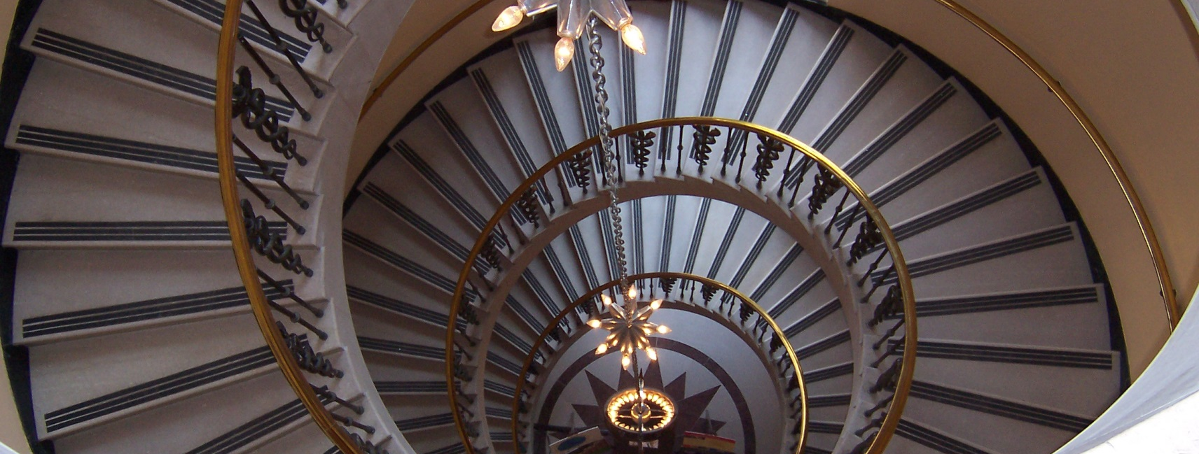
Functional Design Patterns for OO Practitioners

Slide 2
Introduction
Our background
We are…
Software Engineers working in Schlieren.
members of the focus group “Reactive Solutions” in Switzerland.
coding in Java for profit and in Scala for fun.
We believe that…
we should care about functional programming. It is (a part of) the future.
functional concepts are complementary to OO.
Notes:
Growing popularity of functional language concepts in OO languages

Slide 3
Introduction
Our mission
We’ve been thinking about:
What is the best part of functional programming?
Which functional concepts could be helpful in an object-oriented world?
We want to…
give you ideas of how to use your new tools.
show you how simple and yet powerful functional programming is.

Slide 4
Introduction
Functional Programming in 1 slide
It’s all about transforming values
Concepts focus on expressing and composing value transformations
x
y
y
z
y=f(x), z=g(y)
z=g(f(x))

Slide 5
Introduction
Functional patterns
There is no authoritative list of functional patterns (like «Gang of 4» patterns in OO).
«Functional pattern» is a less concise term.
Language-dependent
Focus on composition of functions rather than composition of objects
Our collection consists of ideas and recipes.

Slide 6
Outline
Pure Functions
How to raise awareness for side effects
Chaining Map and FlatMap
Context types: List, Option, Future
Reactive programming
Structural sharing
Lenses
Higher-Order Functions
Immutability

Slide 7
Pure Functions

Slide 8
Pure Functions
Introduction
FP practitioners claim they write side effect free programs.
How is that possible? Is it at all? Why would that be desirable?
Definition: Pure Functions
A function, where the return value is only determined by the input value
A function without side effects
I/O, logging, external system calls
A pure function cannot depend on hidden state or value or I/O
An invocation of a pure function can always be replaced with its return value

Slide 9
Pure Functions
Example: Buy coffee!
CreditCard
Cup
buyCoffee
charge
side effect!
CreditCard Transaction Backend

Slide 10
Pure Functions
Example: Buy coffee! Pure version
CreditCard
Cup
buyCoffee
Charge
Holds information for the credit card backend, but does not result in a side effect
Side effect encapsulated
‘buyCoffee’ is now pure
Caller needs to deal with side effects
Concerns separated
Caller can decide to batch / optimize side effects

Slide 11
Pure Functions
Benefits
Functions are easier to test and verify
Simplifies concurrency, calls to pure functions can be parallelized
Caching: Since the result for a given input is always the same, it only needs to be computed once
Lazyness: Since the function does not cause any side effects, we can postpone computation until we actually need the result

Slide 12
Pure Functions
Outcomes
Obviously, there will be functions with side effects (I/O, global state, user input …)
The idea is to refactor as many of your functions into pure functions as possible and wrap them into a shell, which handles side effects
Keep a “healthy balance” between pure and impure functions
Encapsulating side effects and handing them to the caller can help to turn your functions pure

Slide 13
Higher-Order Functions

Slide 14
Higher-Order Functions
What are they?
Passing functions as arguments to other functions
Injecting code of lower level of abstraction into code of higher level of abstraction
Lots of well-known, generic higher-order functions:
filter, exists, forAll, fold, reduce, map, flatMap

Slide 15
Higher-Order Functions
Happy Customers Example
Input: items in the shopping cart
Ouput: IDs of suggested items
An item is suggested if it
is similar to an item in the shopping cart,
but has a higher rating.
Item
id: Int
rating: Int

Slide 16
Higher-Order Functions
For each shopping cart item:
get similar items
remove items with lower rating
only keep IDs
Combine results
Happy Customers Example
Let’s create a function that transforms one item.

Slide 17
Higher-Order Functions
For each shopping cart item:
get similar items
remove items with lower rating
only keep IDs
Combine results
Happy Customers Example
We’ve prepared this for you…

Slide 18
Higher-Order Functions
For each shopping cart item:
get similar items
remove items with lower rating
only keep IDs
Combine results
Happy Customers Example
Filter the list of similar items.
List[Item]
i1
i2
i3
i4
filter ( i.rating > item.rating )
i
true
false
true
true
i1
i3
i4
List[Item]

Slide 19
Higher-Order Functions
For each shopping cart item:
get similar items
remove items with lower rating
only keep IDs
Combine results
Happy Customers Example
Map items to their IDs.
List[Item]
i1
i2
i3
i4
map ( )
i
i.id
1
2
3
4
List[Int]

Slide 20
Higher-Order Functions
For each shopping cart item:
get similar items
remove items with lower rating
only keep IDs
Combine results
Happy Customers Example
Compute the suggestions for each item with our function and merge the resulting lists into one.
List[Item]
i1
i3
i4
i
flatMap ( )
suggestions
8
4
7
9
5
List[Int]

Slide 21
Higher-Order Functions
Review
Code using these standard higher-order functions is
more declarative, less imperative, reveals its intention
easy to reuse, since abstraction layers are separated
chainable
So far, so good
Not everything in the world is a List
Concepts are applicable to a wider range of types

Slide 22
Context Types
Context
Overview
Value
Wrap another type and
add some functionality to the wrapped type.
Example: List[T]
Wrapped type: T
Added functionality: combines multiple values of the wrapped type

Slide 23
Context Type: List[T]
Mapping and flatMapping Lists
List
List
Item
Item
List
map
Item
Int
flatMap
Item
Int
List
List
Int
Int

Slide 24
Context Type: Option[T]
Option
Overview
User
Functionality: Collection of 0 or 1 value
Used instead of nullable types to explicitly denote possibly missing values
def findUser(name: String): Option[User]
val john = findUser(“John”)
> john: Option[User] = Some(User(1, “John”)
val elvis = findUser(“Elvis”)
> elvis: Option[User] = None
Advantage: forces us to deal with missing values
Disadvantage: extracting the Option is cumbersome

Slide 25
Context Type: Option[T]
Map
Option
val john = findUser("John")
john.map(user => user.id)
> res0: Option[Int] = Some(1)
What about Elvis/None?
None is always mapped to None.
No “Null checking” needed,
as long as you stay in the box!
User
map
User
Int
Option
Int

Slide 26
Context Type: Option[T]
FlatMap
Option
def findOrder(userId: Int): Option[Order]
val john = findUser("John")
john.flatMap(user => findOrder(user.id))
What about Elvis/None?
Stay in the box!
But we have to leave the box eventually!
User
Option
flatMap
User
Order
Option
Order

Slide 27
Context Type: Try
Overview
Functionality: Represents the computation of a value, either successful or failed
Used instead of throwing exceptions
def loadUser(id: Int): Try[User]
loadUser(1)
> res0: Try[User] = Success(User(1, “John”))
loadUser(1000)
> res1: Try[User] = Failure(Exception(«user does not exist»))
Try
User

Slide 28
Try
Mapping and flatMapping Trys
Try
Try
User
User
Try
map
User
Int
flatMap
User
Order
Try
Try
Int
Order

Slide 29
Context Type: Future[T]
Mapping and flatMapping Futures
Future
Future
User
User
Future
map
User
Int
flatMap
User
Order
Future
Future
Int
Order

Slide 30
Reactive Programming
Combining what we’ve learned
Stream of values, computed asynchronously
What type would you use?
Future[List[T]]
List[Future[T]]
something else?
Reactive Extensions (Rx)* calls it “Observable”.
* http://reactivex.io

Slide 31
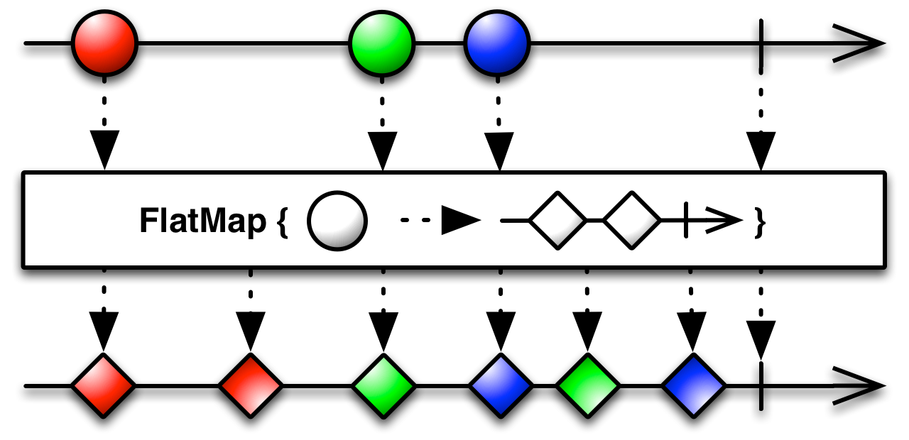
Reactive Programming
Observable
Observables
Event
Guess what, we can map and flatMap it!
Observables can be merged, filtered, split up…
Reactive programming feels like travelling to the future!

Slide 32
Higher-Order Functions
Review
Map and flatMap are the links of a chain of value transformation.
Don’t leave the box (too early)!
Scala even includes a special language construct: for comprehensions
Java 8 Support:
Optional
CompletableFuture: thenApply (map), thenCompose (flatMap)

Slide 33
Immutability

Slide 34
Immutability
Motivation
Advantages of immutability:
Makes concurrent programming easier, safer and cleaner
Reduces need for defensive programming
Representation of value objects (without identity)
Makes it easier to reason about your code
Disadvantages of immutability:
Manipulation of complex objects
Immutable objects do not support destructive updates
Modifications result in an altered copy of the object

Slide 35
Immutability
Modifying simple immutable objects
Person
Address
firstName: String
lastName: String
firstName: John
lastName: Doe
street: String
city: String
street: Wiesenstrasse 10a
city: Schlieren
Person.copy(
lastName = “Smith”
)
Person’
firstName: John
lastName: Smith

Slide 36
Immutability
Operating on immutable collections in Scala
Scala’s collections come in two (flavours:
scala.collection.immutable.Map
scala.collection.mutable.Map
Immutable collections do not support destructive updates
Efficient operations on collections possible by using structural sharing
1
2
3
4
Head
Tail

Slide 37
Immutability
Structural sharing on collections
Prepending: Time & Space O(1)
val a = List(1,2,3,4)
1
2
3
4
val b = 0 :: a
0
Structural Sharing
val c = 3 :: a.tail()
3
Choose the right implementation for your usecase!

Slide 38
Immutability
Modify nested immutable objects
Person
Contact
Address
street: String
Update street with mutable state:
person.contact.address.street = “Wiesenstrasse”
Update street with immutable state:
person.copy(
contact = person.contact.copy(
address = person.contact.address.copy(
street = “Wiesenstrasse”
)))

Slide 39
Lenses
Modify nested immutable objects
Lenses to the rescue!
case class Lens[O,V](get: O => V, set: (O,V) => O)
val streetLens = Lens[Address,String](
address => address.street,
(address, street) => address.copy(street = street)
)

Slide 40
Lenses
Modify nested immutable objects
Compose and conquer
def compose[Outer,Inner,Value](
outerLens: Lens[Outer,Inner],
innerLens: Lens[Inner,Value]
): Lens[Outer,Value] = Lens(
obj => innerLens.get(outerLens.get(obj)),
(obj, value) => outerLens.set(obj,
innerLens.set(outerLens.get(obj), value)
)
)
case class Lens[O,V](get: O => V, set: (O,V) => O)

Slide 41
Lenses
Modify nested immutable objects
Libraries
import rillit.Lenser, shapeless.Lens
val customerStreetLens =
Lenser[Customer].contact.address.street

Slide 42
Immutability
Outcomes
Immutability is a generally desirable feature
Write new code or refactor existing code always with immutability in mind
Default to immutability. Switch to mutable data structures for specific purposes only
Patterns like lenses can mitigate the added complexity when dealing with destructive updates

Slide 43
How everything fits together
Pure Functions
Higher-Order Functions
Immutability
Pure functions do not mutate anything.
It’s easy to write pure functions with immutable data structures!
Be careful when passing impure functions to higher-order functions!
Immutable data structures give the higher-order functions the freedom to do magic!

Slide 44
How will all this impact your code?
Download slides and code examples from:
https://github.com/aax/zdays-fp-patterns

Slide 45
Sources
http://de.slideshare.net/vkostyukov/purely-functional-data-structures-in-scala-26175521

